Slide 1


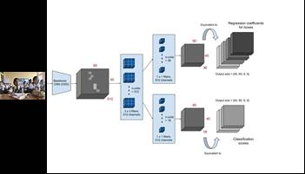
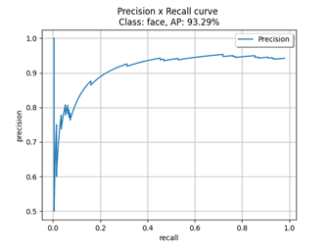
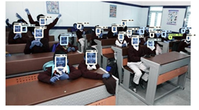
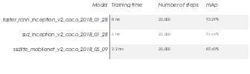
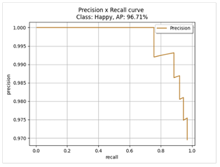
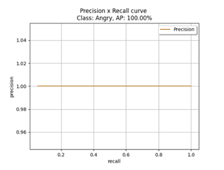
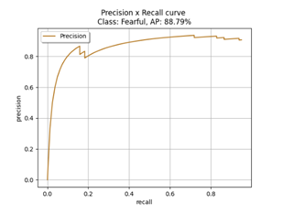
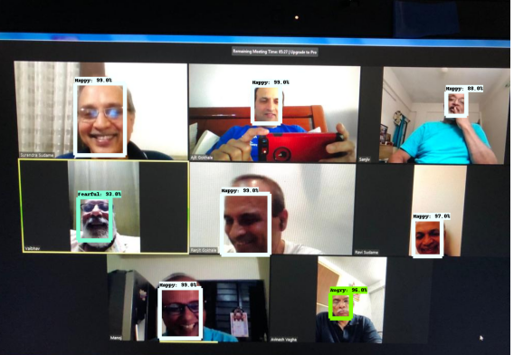
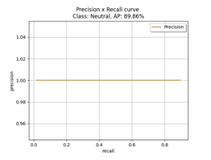
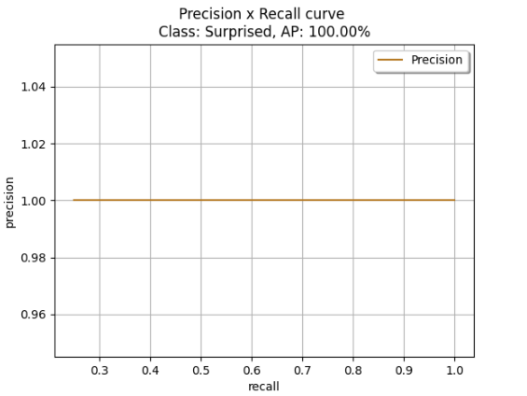
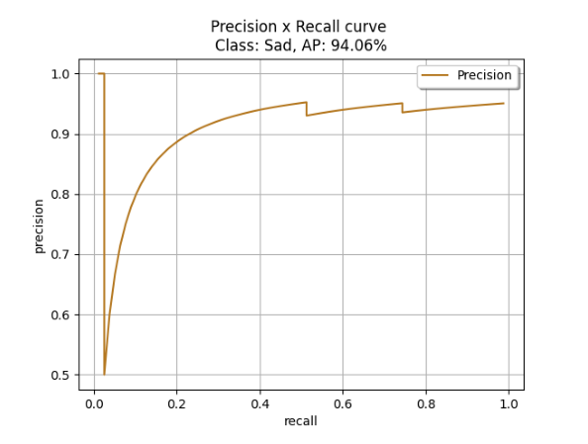
Group Visual Sentiment detection via Object detection and Convolutional Neural Network
Narayana D¹, Radhika Pradeep ¹ Anuja Kulkarni ¹ Shruti Mrinalan ¹ Ruchira Mudliar ¹ Kavyal ¹ Great Lakes Executive Learning
ABSTRACT
INTRODUCTION
DISCUSSION
This paper focuses on studying group’s emotion detection. Contemporary world is heading towards AI where every second creates a new vision with an enormous change. In AI, Face recognition is one of the fastest growing domains. Instead of using traditional methods for marking emotions, we propose to automate it by identifying human faces with unique features of their faces, known as Face Recognition. Face detection is a prerequisite step for emotion detection. Face detection aims to identify and locate all faces regardless of their position, scale, orientation, lighting conditions, expression etc. We created a model using SSD lite object detection, Faster RCNN object detection model and SSD Inception net embeddings. Widenet data was used to identify face location and crop faces and FER data set was used to predict emotion/sentiments
.The focus of our paper lies in building a multimodal sentiment recognition system that can be used to analyze the emotions of the students in classrooms. This is essential in the present scenario, with the advent of digital classrooms the interaction between the student and the instructor has decreased considerably. Also, with smartphones and social media, there are innumerable distractions to the students, letting them to lose focus and their attention span has reduced significantly. This initiates the necessity to develop a multimodal system that can capture their emotions in real-time and associate it with a feeling that clearly represents their mood in the classroom. Our system uses a video camera to capture the faces of the students and the frames are extracted to split the and video for processing and classification.
The usage of this can be in classrooms (face to face and Virtual), conferences, and any face to face interactions where you need to observer or understand other persons sentiments
Experimental results have shown that the proposed face recognition system using Faster RCNN approach has successfully recognized different human faces and recognized emotions more accurately
The emotion detection using facial recognition proves to be secure, reliable and fast
and can also significantly improve the understanding of student's sentiments especially in the time where we are having virtual classrooms
We also introduce a combination of using 2 models for face detection where in if one model fails to identify a face in the frame, it is passed to second model which will again try to identify face in the image. These steps increase thetotal durability of our model
Figure 3. Modified Faster RCNN – Object detecton
Figure 4. Architecture of Other models used
RESULTS
Table 2. Performance on Egypt AUC Data after re-training.
Initially the above described model is used with the 30,000 training images and 1000 validation images from Kaggle dataset considering the amount of time it takes to train the model with the available resources. The performance of the model remained same after training on 5000 training images and 2200 validation images. The validation accuracy of the model trained with 20000 images is 0.32 on Faster RCNN (weighted F1-score) in comparison to validation accuracy of1.1717 (weighted F1-score) of model trained with SSD mobilenet.
Data from wider data and FER was converted to pascal voc. Google Colab is used for training with number of epochs set as 50. The framework was developed using Keras. We have used Model Checkpoint and Early stopping to save the weights of best performing epoch.
METHODS AND MATERIALS
A. Video Images collection & Storage: Video files from virtual videos, classroom cctv and from camera recordings of people/students to be taken for analysis of sentiment
B.Converting video into frames :Each of the individual videos are converted into frames and picture. If images are provided, same is used as is into the model describe in C.
C.Predicting Faces: Each image is passed into the pre=trained model which predicts faces and stores each face against he image
D.Predicting Emotion from Faces: Each of the individual face is then taken into emotion prediction model to predict the 7 types of emotions
CONCLUSIONS
This paper addresses the solution of identification of emotions. For face identification Faster RCNN was much better than the other models. And for emotions detection simple CNN was giving better accuracy on test images
2)We were able to achieve 94% with SSD inception net, however with Faster RCNN the predictions on new data set was better for emotion detection
3) Images/Video with very less lighting, faces are not properly detected. Also the recommendation is to keep the CCTV in a place where all people faces are visible and enough light on all children. In the classroom image few faces were not visible and these faces could not be detected
Table 1. Model Performance
REFERENCES
CONTACT
[1] Wei Liu1,, Dragomir Anguelov2,, Dumitru Erhan3,, Christian Szegedy3,Scott Reed4, Cheng-Yang Fu1, Alexander C. Berg “SSD: Single Shot MultiBox Detector” 29 Dec 2016
[2] "Challenges in Representation Learning: A report on three machine learning contests." I Goodfellow, D Erhan, PL Carrier, A Courville, M Mirza, B Hamner, W Cukierski, Y Tang, DH Lee, Y Zhou, C Ramaiah, F Feng, R Li,
[3] Shaoqing Ren, Kaiming He, Ross Girshick, Jian SunK. Elissa, “Faster R-CNN: Towards Real-Time Object Detection with Region Proposal Networks 4 Jun 2015.
Radhika Pradeep
Great lakes
Email: Radhika.Pradeep@gmail.com
Phone: 9923561611
Website:
Figure 1. Sample Data Image.

